Slide 1

GreenCycle
Name:
Naba Yahya - 20193627
Alanood Abdulaziz - 202009426
Manar Eyad Ahmed - 202006306
Fatema Hussain Habib - 20192408

Slide 2

INTRODUCTION
Our business is the green cycle, it is an online app for recycling old items into new items and selling them. Recycling is a process of making new materials and objects from waste materials. Mainly people depend on converting waste materials into new materials for many reasons. It results in less energy and less pollution.

Slide 3














BUSINESS IDEA
Problem
Solution
There is a growing concern about
the negative impact of waste on the
environment. Many people have old
items that they no longer use
but do not know how to dispose
of responsibly.
Our business will collect and recycle old
items from customers into new ones. We will
use sustainable materials and processes to
create high-quality products that are
both functional and aesthetically pleasing.
Objectives
Uniqueness
First, we will reduce waste and promote sustainability by giving old items a new life. We will provide customers with high-quality, and we will create jobs in our local community and contribute to economic growth.
First, we will focus on upcycling. Second, we will
use digital technologies and make it easy for
customers to participate in our recycling program.

Slide 4



Mission and Vision
Vision
To be the biggest
business that turns waste into
valuable, innovative products
to achieve environmental
sustainability
Mission
The mission is to provide customers with
the most innovative recycled products while
reducing or eliminating environmental pollution
and global warming

Slide 5


SWOT analysis
Opportunities
Strengths
• Ability to collaborate with large companies.
• Use of new technology
• Market growth in this area to protect
the environment.
• There is a large amount of waste available
to recycle.
• Good Customer Service
• Strong System for recycling
• offering courses and training
sessions for staff
• Highly experience team
with strong leadership
Threats
• New and Many competitors
• It’s difficult to reach the global market due
to the laws and regulations in different countries
around the world.
• Difficulties in control and monitoring
Weaknesses
• High Cost
• The process of manufacturing and
recycling products takes a long time.

Slide 6

Business Model
Customer value
proposition
customer
relationships
Green Cycle aim to attract more
customers by providing them
with solutions for their problems
to satisfy their needs.
We want to build a strong,
long-term relationship with our customers
customer segments
Revenue
we focused on targeting People with limited
income and employees, as we help them to
provide high-quality goods at a price that
satisfies all parties.
we generate our revenue from selling our recycled products to customers as well as by running advertisements on social media and within the application itself.

Slide 7



Digital Content Strategy
Creating
Delivery
It must be approved by the municipality and it will be loaded on all system. The application will be constantly updated.
Creating content
providing products and services
as well as educate the user about recycling at the same time. It
must be established under
the license. The content will be organized in a simple.
Creating
Governance
We have set content evaluation criteria whereby 2000 visitors must be visited within a month. Also, the content will be developed and updated continuously.

Slide 8

Digital Business Canvas
BUSINESS GOALS AND OBJECTIVES Type of digital business: an online store that recycles old items into new items and sells them. Business objective: reduce waste and promote sustainability and provide customers with new high-quality recycled items. |  | COMPETITORS Closest competitor: BAHRAIN CONTRACT CLEANING. It is a recycling factory that recycles plastic and metals, that is located in Salmabad. How will you be different or better? Provide delivery services. Recycle old items into new items. Sell recycled items.
ACQUISITION Keyword search phrase: green, recycle, Bahrain recycle. Visitors/month:2000 | BEHAVIOR Available domain name: greencycle.online Most important use case: The customer can purchase the recycled items which will be delivered to their destination. Anyone can buy the items. | CONVERSIONS Primary conversion goal: SIGN UP LOG IN CHOOSE WHAT TO RECYCLE ADD ADDRESS PRODUCTS THAT ARE FOR SALE PAYMENT Revenue stream: Our revenue will come from the sale of our upcycled products, as well as from the fees that we charge for collecting and recycling old items and from advertising.
Social media platform: Instagram Content and frequency: images of items before and after, the importance of recycling, awareness instructions, and promotions. Visitors/month:10,000
CONVERSION EQUATION Primary conversion goal: 2000 visitors/month * 10 % conversion rate = 200 conversions/month

Slide 9


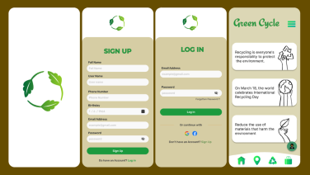
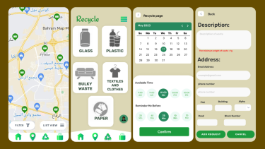
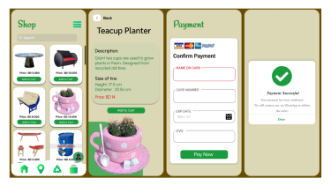
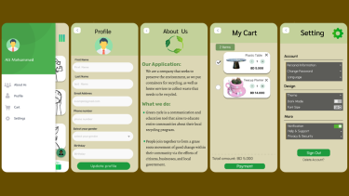
App Design

Slide 10
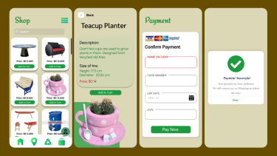
App Design

Slide 11
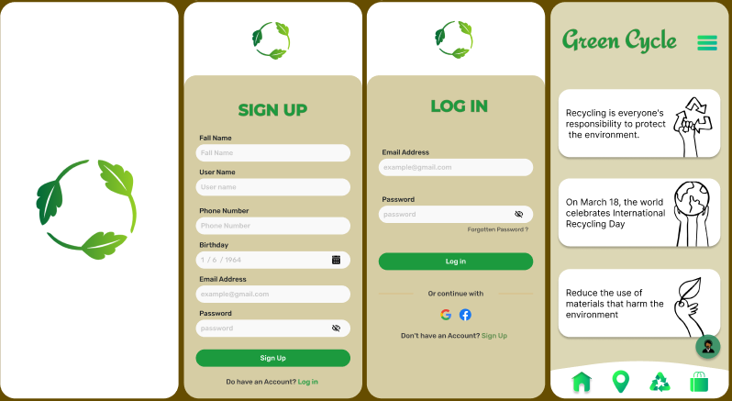

Slide 12
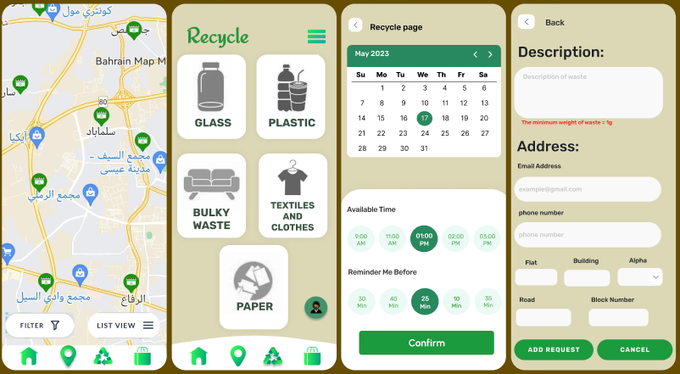

Slide 13
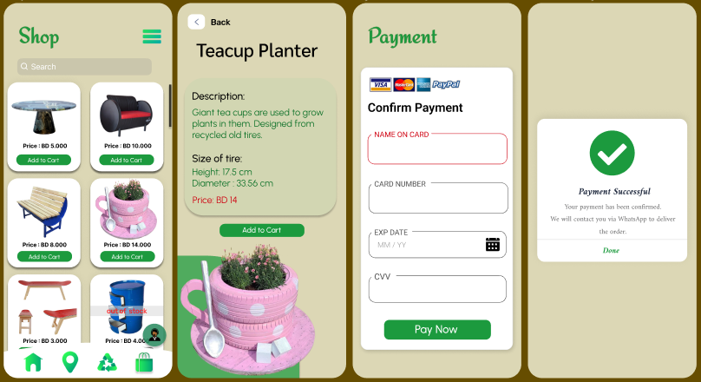

Slide 14
